Slide 1



GEMINI PRO FINANCIAL AI
SMART AI FOR FINANCIAL ANALYSIS

Slide 2



ABOUT
Gemini Pro Financial Decoder is an AI-powered tool that analyzes financial statements using Google’s Gemini Pro. It extracts key metrics, summarizes insights, and detects financial trends, helping businesses and investors make data-driven decisions. The tool simplifies complex financial data into structured, actionable insights for better financial analysis.

Slide 3


CHALLENGES
IMPACT
Financial analysts waste hours manually analyzing reports.
Non-financial stakeholders struggle to understand complex reports.
Manual processing leads to errors & delays.
Time-consuming report generation.
Misinterpretation of financial data.
Inefficient decision-making.

Slide 4


OUR SOLUTION - GEMINI PRO FINANCIAL DECODER
AI-POWERED FINANCIAL ANALYSIS TOOL
KEY CAPABILITIES
TECH STACK USED
Uses AI to extract key insights from financial reports, saving time and reducing human effort.
Converts raw financial data into intuitive charts and graphs for quick analysis.
Provides AI-driven recommendations to help businesses and investors make informed financial choices.
Summarizes financial reports automatically.
Generates visual insights using charts.
Enhances decision-making for financial & non-financial users.
GenAI (Gemini Pro) for financial data analysis
Streamlit for web-based UI
Plotly for interactive financial visualizations

Slide 5

KEY FEATURES
AI-Powered Report Summarization
Interactive Financial Visualizations
Fast & User-Friendly Interface

Slide 6

Step 1
Upload financial reports (CSV format).
Step 2
AI analyzes the data & generates key insights.
Step 3
HOW IT WORKS
Visual dashboards display financial health.
Step 4
AI provides summary reports for better decision-making.

Slide 7

Technologies Used
Google Gemini Pro
GitHub
Streamlit
Python
Plotly

Slide 8
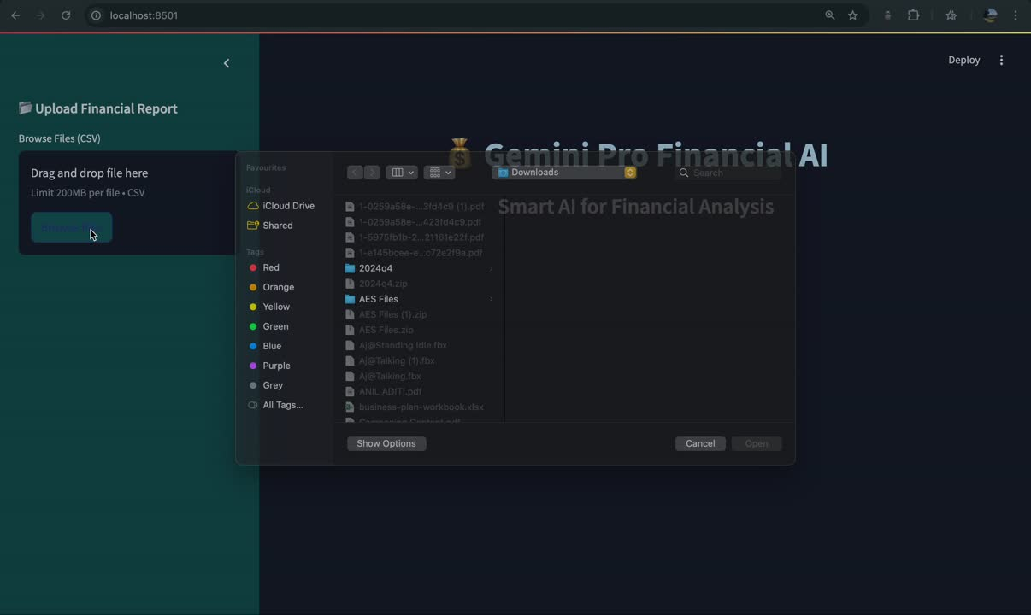
DEMO - VIDEO

Slide 9
COMPETITIVE EDGE
Why Gemini Pro is better than traditional methods?
Automation: Saves 80% of manual effort.
Accuracy: AI-powered reports reduce errors.
User-Friendly: No finance expertise required!
Future Scope:
Expand AI to support PDF reports & real-time analytics.
Add risk assessment & fraud detection capabilities.

Slide 10
CHALLENGES & LEARNINGS
Challenges Faced
Working with financial datasets.
Optimizing AI-generated responses.
Streamlining UI for non-financial users.
Key Learnings
Effective team collaboration.
Leveraging AI for finance can revolutionize decision-making.

Slide 11





THE TEAM - NEONOVA
VAISHNAVI
(TEAM LEAD)
ADITI
SHRUTHI
SIRINMAI
GREESHMA

Slide 12
THANK YOU

